Slide 1
CSS 422 Hardware and Computer Organization
68000 instruction decomposition
Professor: Yang Peng
The slides are re-produced by the courtesy of
Dr. Arnie Berger and Dr. Wooyoung Kim

Slide 2
Topic
68000 Instruction Set Architecture
Instruction Set Decomposition
68K manual
Chapter 8 (Berger)
Chapter 2, 3 (Clements)

Slide 3
Instruction Decomposition
Assemble (decompose): Translate assembly code to machine code
Why need assembling?
The memory system can store binary numbers only
Basically, all assembly languages should be translated into a set of binary numbers to be stored or understood by the computer system
Disassemble: Translate machine code to assembly code
Why need disassembling?
It helps you understand assembly programming
You may need it in your future work
Software engineer in software security related area

Slide 4
68000 Instruction Format
Instruction set in a memory
Assembly codes are assembled into binary numbers and stored in memory
One instruction code can be up to 5 words – 80 bits
10 = 2 + 4 + 4
For example,
MOVE.B #14, D0 → 103C 000E (machine code in hex)
MOVE.W $0010AA00,$00103000 → 33F9 0010AA00 00103000
The first 16-bit (e.g., $103C, $33F9) of an instruction is called the Opcode Word
contains all of the information needed to decode the rest of the instruction
contains the Opcode and Effective Address (EA) fields
The complete instruction in memory must contain the opcode word and may contain additional words to complete the instruction

Slide 5
Instruction Format in Memory
Example: Only op-code word
Generally represented as OPCODE
Example:
MOVE.B D3, D0 → 1003
EVEN BYTE ODD BYTE
7 6 5 4 3 2 1 0 7 6 5 4 3 2 1 0
15 14 13 12 11 10 9 8 7 6 5 4 3 2 1 0
It is a MOVE.B instruction
The source operand is register D3
The destination operand is register D0
OP CODE WORD
FIRST WORD SPECIFIES OPERATIONS AND MODES
SOURCE EFFECTIVE ADDRESS EXTENSION
IF ANY, ONE OR TWO WORDS
Not used
DESTINATION EFFECTIVE ADDRESS EXTENSION
IF ANY, ONE OR TWO WORDS

Slide 6
Instruction Format in Memory (2)
Example: an immediate operand is the actual data value
Generally represented as OPCODE #DATA (min. unit is word)
Example:
MOVE.B #14, D0 → 103C 000E
EVEN BYTE ODD BYTE
7 6 5 4 3 2 1 0 7 6 5 4 3 2 1 0
15 14 13 12 11 10 9 8 7 6 5 4 3 2 1 0
It is a MOVE.B instruction
The source operand is immediate data
The destination operand is register D0
OP CODE WORD
FIRST WORD SPECIFIES OPERATIONS AND MODES
SOURCE EFFECTIVE ADDRESS - IMMEDIATE OPERAND
IF ANY, ONE OR TWO WORDS
The immediate data value, $000E
DESTINATION EFFECTIVE ADDRESS EXTENSION
IF ANY, ONE OR TWO WORDS
Not used

Slide 7
Instruction Format in Memory (3)
Example: an absolute operand is the actual data value
Generally represented as OPCODE source EA, dest EA
MOVE.W $0010AA00,$00103000 → 33F9 0010AA00 00103000
EVEN BYTE ODD BYTE
7 6 5 4 3 2 1 0 7 6 5 4 3 2 1 0
15 14 13 12 11 10 9 8 7 6 5 4 3 2 1 0
It is a MOVE.W instruction
The source operand is absolute address
The destination operand is absolute
address
OP CODE WORD
FIRST WORD SPECIFIES OPERATIONS AND MODES
SOURCE EFFECTIVE ADDRESS
HIGH ORDER WORD
SOURCE EFFECTIVE ADDRESS
LOW ORDER WORD
$0010
DESTINATION EFFECTIVE ADDRESS
HIGH ORDER WORD
$AA00
$0010
DESTINATION EFFECTIVE ADDRESS
LOW ORDER WORD
$3000

Slide 8
Effective Address
The effective address, EA, determines how the operands of an instruction are to be accessed by the processor
Different types of EA’s determine the processor’s addressing modes
In 68K manual, each instruction has different codes for each EA mode:
Dn: data register direct: D0, D1, …, D7
An: address register direct : A0, A1, …, A6
(An): address register indirect: (A0), (A1), …, (A6)
(An)+: address register indirect with post-increment
-(An): address register indirect with pre-decrement
(d₁₆, An): address register indirect with displacement
(EA = (An)+ d₁₆)
(d₈, An, Xn): address register indirect with index
(EA = (An)+(Xn)+ d₈)
(xxx).W: Absolute addressing (word)
(xxx).L: Absolute addressing (long-word)
#<data>: Immediate Addressing
(d₁₆, PC): Program counter with displacement (EA = (PC)+ d₁₆)
(d₈, PC, Xn): Program counter with index (EA = (PC)+(Xn)+ d₈)

Slide 9
Assemble manually?
The processor manual tells you what you need to know!

Slide 10
Format of the 68000 Instructions Set (1)
Two Operands Operation
E.g., MOVE, MOVEA
MOVE instruction: Move the contents at the memory location specified by the src EA to the memory location specified by the dst EA
It’s opcode word is shown below:
This information is encoded in the 16 bits of the opcode word
OPCODE/SIZE = Bit15-12
Destination Effective Address = Bit11-6
Source Effective Address = Bit5-0
May have to retrieve additional words from memory to complete the instruction
Note: Not all instructions have the same form as the MOVE instruction
Refer the 68K manual
MOVE
dst EA
src EA
15 12 11 6 5 0

Slide 11
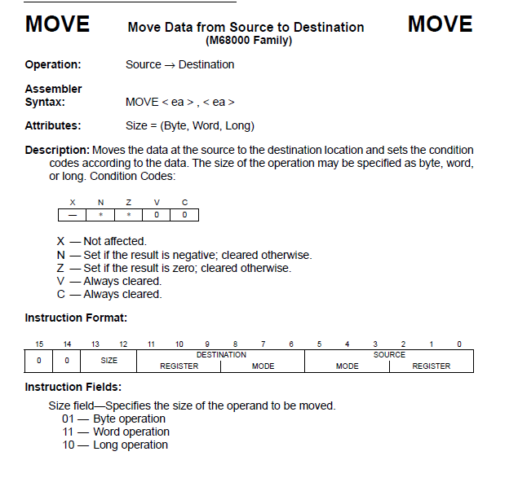
68K Manual

Slide 12
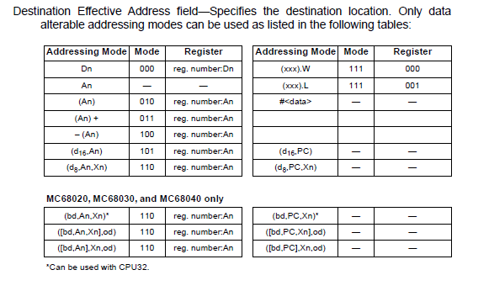
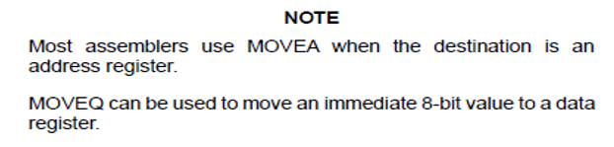
68K Manual

Slide 13
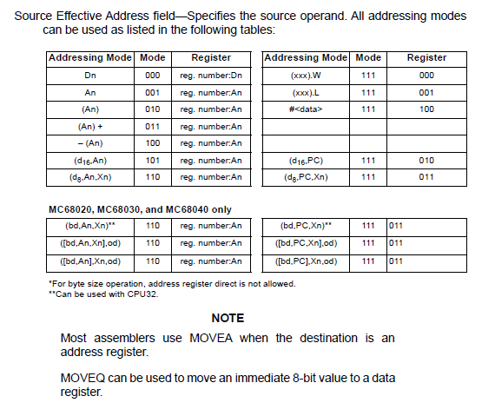
68K Manual

Slide 14
Decomposing the MOVE Instruction
Refer the 68K manual for instruction format
Recall that the MOVE instruction format was shown as:
According to the 68K manual, we can decompose this further to:
Opcode word: MOVE.B D3, D0
opcode
dst EA
src EA
15 12 11 6 5 0
0 0
SIZE
DESTINATION
REGISTER
DESTINATION
MODE
SOURCE
MODE
SOURCE
REGISTER
15 14 13 12 11 10 9 8 7 6 5 4 3 2 1 0
MSB
LSB
Dest = D0
Source = D3

Slide 15
68K Manual

Slide 16
68K Manual

Slide 17
Decomposing the MOVE Instruction
Refer the 68K manual for instruction format
Recall that the MOVE instruction format was shown as:
According to the 68K manual, we can decompose this further to:
Opcode word: MOVE.B D3, D0
1003
opcode
dst EA
src EA
15 12 11 6 5 0
0 0
SIZE
DESTINATION
REGISTER
DESTINATION
MODE
SOURCE
MODE
SOURCE
REGISTER
15 14 13 12 11 10 9 8 7 6 5 4 3 2 1 0
MSB
LSB
Dest = D0
Source = D3
0 | 0 | 0 | 1 | 0 | 0 | 0 | 0 | 0 | 0 | 0 | 0 | 0 | 0 | 1 | 1

Slide 18
Decomposing the MOVE Instruction (2)
Refer the 68K manual for instruction format
Recall that the MOVE instruction format was shown as:
According to the 68K manual, we can decompose this further to:
Opcode word: MOVE.B #14, D0
opcode
dst EA
src EA
15 12 11 6 5 0
0 0
SIZE
DESTINATION
REGISTER
DESTINATION
MODE
SOURCE
MODE
SOURCE
REGISTER
15 14 13 12 11 10 9 8 7 6 5 4 3 2 1 0
MSB
LSB
Dest = D0
Source = #14

Slide 19
68K Manual

Slide 20
68K Manual

Slide 21
Decomposing the MOVE Instruction (2)
Refer the 68K manual for instruction format
Recall that the MOVE instruction format was shown as:
According to the 68K manual, we can decompose this further to:
Opcode word: MOVE.B #14, D0
Finished?
opcode
dst EA
src EA
15 12 11 6 5 0
0 0
SIZE
DESTINATION
REGISTER
DESTINATION
MODE
SOURCE
MODE
SOURCE
REGISTER
15 14 13 12 11 10 9 8 7 6 5 4 3 2 1 0
MSB
LSB
Dest = D0
Source = #14
0 | 0 | 0 | 1 | 0 | 0 | 0 | 0 | 0 | 0 | 1 | 1 | 1 | 1 | 0 | 0

Slide 22
Decomposing the MOVE Instruction (2)
Refer the 68K manual for instruction format
Recall that the MOVE instruction format was shown as:
According to the 68K manual, we can decompose this further to:
Opcode word: MOVE.B #14, D0
Finished? No, you need one more word for the number #14
opcode
dst EA
src EA
15 12 11 6 5 0
0 0
SIZE
DESTINATION
REGISTER
DESTINATION
MODE
SOURCE
MODE
SOURCE
REGISTER
15 14 13 12 11 10 9 8 7 6 5 4 3 2 1 0
MSB
LSB
Dest = D0
Source = #14
0 | 0 | 0 | 1 | 0 | 0 | 0 | 0 | 0 | 0 | 1 | 1 | 1 | 1 | 0 | 0

Slide 23
Decomposing the MOVE Instruction (2)
Refer the 68K manual for instruction format
Recall that the MOVE instruction format was shown as:
According to the 68K manual, we can decompose this further to:
Opcode word: MOVE.B #14, D0
103C 000E
opcode
dst EA
src EA
15 12 11 6 5 0
0 0
SIZE
DESTINATION
REGISTER
DESTINATION
MODE
SOURCE
MODE
SOURCE
REGISTER
15 14 13 12 11 10 9 8 7 6 5 4 3 2 1 0
MSB
LSB
Dest = D0
Source = #14
0 | 0 | 0 | 1 | 0 | 0 | 0 | 0 | 0 | 0 | 1 | 1 | 1 | 1 | 0 | 0

Slide 24
Decomposing the MOVE Instruction (3)
Refer the 68K manual for instruction format
Recall that the MOVE instruction format was shown as:
According to the 68K manual, we can decompose this further to:
Opcode word: MOVE.W $0010AA00, $00103000
opcode
dst EA
src EA
15 12 11 6 5 0
0 0
SIZE
DESTINATION
REGISTER
DESTINATION
MODE
SOURCE
MODE
SOURCE
REGISTER
15 14 13 12 11 10 9 8 7 6 5 4 3 2 1 0
MSB
LSB
Dest = $00103000
Source = $0010AA00

Slide 25
Absolute Addressing Range
00000000
Low 32K bytes accessible by 16-bit word addressing
00007FFF
Sign Extension
Addresses require
32-bit long addressing
FFFF8000
High 32 Kbytes accessible by 16-bit word addressing
FFFFFFFF

Slide 26
68K Manual

Slide 27
68K Manual

Slide 28
Decomposing the MOVE Instruction (3)
Refer the 68K manual for instruction format
Recall that the MOVE instruction format was shown as:
According to the 68K manual, we can decompose this further to:
Opcode word: MOVE.W $0010AA00, $00103000
opcode
dst EA
src EA
15 12 11 6 5 0
0 0
SIZE
DESTINATION
REGISTER
DESTINATION
MODE
SOURCE
MODE
SOURCE
REGISTER
15 14 13 12 11 10 9 8 7 6 5 4 3 2 1 0
MSB
LSB
Dest = (xxx).L
Source = (xxx).L
0 | 0 | 1 | 1

Slide 29
Decomposing the MOVE Instruction (3)
Refer the 68K manual for instruction format
Recall that the MOVE instruction format was shown as:
According to the 68K manual, we can decompose this further to:
Opcode word: MOVE.W $0010AA00, $00103000
opcode
dst EA
src EA
15 12 11 6 5 0
0 0
SIZE
DESTINATION
REGISTER
DESTINATION
MODE
SOURCE
MODE
SOURCE
REGISTER
15 14 13 12 11 10 9 8 7 6 5 4 3 2 1 0
MSB
LSB
Dest = (xxx).L
Source = (xxx).L
0 | 0 | 1 | 1 | 0 | 0 | 1 | 1 | 1 | 1 | 1 | 1 | 1 | 0 | 0 | 1

Slide 30
Decomposing the MOVE Instruction (3)
Refer the 68K manual for instruction format
Recall that the MOVE instruction format was shown as:
According to the 68K manual, we can decompose this further to:
Opcode word: MOVE.W $0010AA00, $00103000
Finished?
opcode
dst EA
src EA
15 12 11 6 5 0
0 0
SIZE
DESTINATION
REGISTER
DESTINATION
MODE
SOURCE
MODE
SOURCE
REGISTER
15 14 13 12 11 10 9 8 7 6 5 4 3 2 1 0
MSB
LSB
Dest = (xxx).L
Source = (xxx).L
0 | 0 | 1 | 1 | 0 | 0 | 1 | 1 | 1 | 1 | 1 | 1 | 1 | 0 | 0 | 1

Slide 31
Decomposing the MOVE Instruction (3)
Refer the 68K manual for instruction format
Recall that the MOVE instruction format was shown as:
According to the 68K manual, we can decompose this further to:
Opcode word: MOVE.W $0010AA00, $00103000
33F9 0010AA00 00103000
opcode
dst EA
src EA
15 12 11 6 5 0
0 0
SIZE
DESTINATION
REGISTER
DESTINATION
MODE
SOURCE
MODE
SOURCE
REGISTER
15 14 13 12 11 10 9 8 7 6 5 4 3 2 1 0
MSB
LSB
Dest = (xxx).L
Source = (xxx).L
0 | 0 | 1 | 1 | 0 | 0 | 1 | 1 | 1 | 1 | 1 | 1 | 1 | 0 | 0 | 1

Slide 32
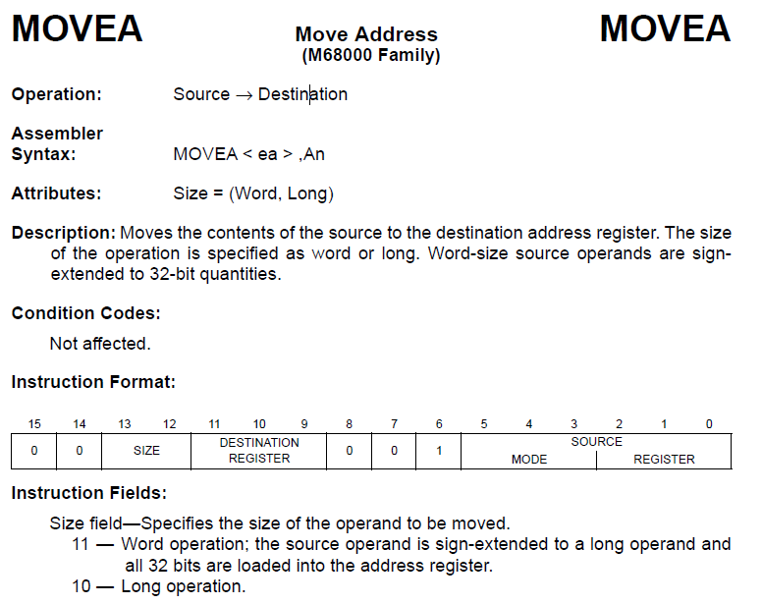
The MOVEA instruction is a special form of the MOVE instruction and is used if the destination (dst) is an Address Register
MOVEA.W and MOVE.W have the same opcodes

Slide 33
MOVEA Notes
Why providing both MOVEA and MOVE?
In a 68K processor, word accesses must be aligned on word boundaries
If the same instruction was used to store data in an address register, it would be possible to store an odd address value and cause a non-aligned access to occur
A runtime error will happen!
MOVE.W #1110, D1 -> Valid according to 68K manual!
MOVE.W #1110, A1 -> Invalid according to 68K manual!
The destination register of MOVE operation cannot be Address Register
The Easy68K simulator has a bug that can accept this operation!

Slide 34
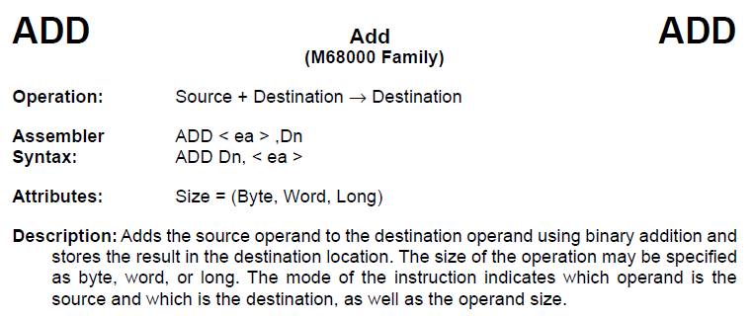
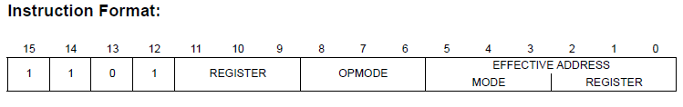
Format of the 68000 Instructions Set (2)
Use an internal register as the source or destination of the operation (i.e., ADD, AND, CMP)
opcode
register
op mode
src or dst EA
15 12 11 9 8 6 5 0

Slide 35
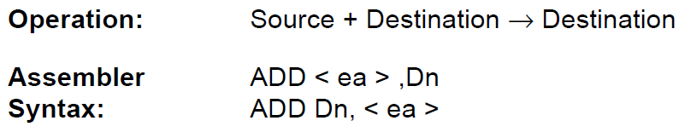
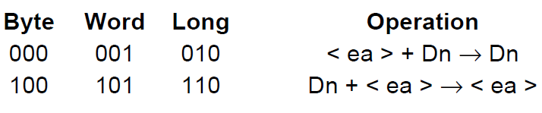
Specifies any of the eight data registers
Effective Address field—
If the location specified is a source operand, all
addressing modes can be used
If the location specified is a destination operand, only
memory alterable addressing modes can be used

Slide 36
Exercise
1. Assemble by hand the following assembly language MOVE and ADD instructions
MOVE.B (A0) ,D7
MOVE.L $1234,D7
MOVEA.W D7,A0
ADD.W D0,D7

Slide 37
Exercise - Illegal Instructions
Explain why the following codes are illegal
MOVE.W $2233,A5
Answer: A5 is an Address register
MOVE.B #$2233,D6
Answer: #$2233 is a word (2 bytes)
ADD.W D0,#$1000
Answer: #$1000 is an immediate number, which cannot be a destination in ADD operation
MOVEA.B D7,A0
Answer: MOVEA can only operate on Word or Long, but not Byte
MOVEA.W A0,$1234
Answer: Destination must be an Address register for MOVEA operation

Slide 38
Format of the 68000 Instructions Set (3)
Single operand instructions, i.e., CLR (clear the contents of the dst EA)
An opcode word + rest of instruction (sometimes do not have)
opcode
opcode
mode
register
15 6 5 3 2 0
JMP (Jump) and JSR (Jump to Sub-Routine) are single-operand instructions
JMP: Change the value of the Program Counter (PC)
Next instruction is fetched from <PC>
JSR is a special type of jump instruction
Replaces <PC> with operand but also saves the current <PC> on the stack
Can return to starting point with RTS
Used for interrupt subroutines or ISR’s and function calls

Slide 39
Format of the 68000 Instructions Set (4)
Branch instructions
Change the program counter value to a new value if a test condition is true
Test conditions are represented by the state of the flags in the Condition Code Register (CCR)
Tests can be, zero, overflow, carry or borrow, negative
opcode
condition
displacement
15 12 11 8 7 0
Destination of the branch is calculated by adding the current value of the program counter to the displacement value in the instruction
Uses 2’s complement, signed addition

Slide 40
Format of the 68000 Instructions Set (5)
Inherent addressing: The effect (dst or src) of the opcode is inherently contained in the function of the opcode
RTS: ReTurn from Subroutine:
JSR instruction PUSH the return location on the stack
RTS only needs to POP the <PC> in order to get back from the subroutine
opcode
15 0

Slide 41
Some Representative Instructions
CLR.B ddst 0100001000dddddd
Clear (set to zero) the byte of the data destination operand – ddst
BNE displacement 01100110dddddddd
Branch if the result is Not Equal to zero ( Zero flag = 0 )
BEQ displacement 01100111dddddddd
Branch if the result is EQual to zero ( Zero flag = 1 )
JMP cdst 0100111011dddddd
Jump to the address defined by control destination operand, cdst
RTS 0x4E75
Notice that the RTS instruction does not require an operand

